Slide 1
Trutex CRM/ERP Integration
Project
Priority to ZCRM
Specification and
Supporting Detail
22/7/2019

Slide 2
Introduction 1.0
One of the primary and basic functions of the Trutex Zoho CRM (ZCRM) platform is to “front end” Priority to allow:
Non Priority users to access and interrogate Priority, without having to access Priority
Account management to have visibility of all events around their accounts
To allow enhanced CRM functionality around and to front end ERP operations
Improved BI without a need for Phocas for Sales, Ops and Finance
Shared BI to all and no need for Phocas access
Use Zoho CRM automation to reduce/remove daily and routine manual reports
Use Zoho Workflow to drive SOPs, inform planned and scheduled actions and keep Customers fully informed
therefore, essentially “wrapping“ Priority with ZCRM.
To achieve this, the selected Priority data items (as selected by Trutex Customer Services and Sales teams) will be synced with matching data modules in ZCRM in real time, on record creation and edit, via ZCRM’s published REST V2 API interface and methods.
At this stage of the project, data traffic direction is one way Priority to ZCRM so all new record instances and edits to existing selected modules’ records will ONLY take place in Priority, and Priority will remain the Single View Of the Truth (SVOT) and the Master Data Store for:
Customers
Customer to Customer/School Links
Customer Contacts
(Customer) Pricelists
Part Catalogue
Part Prices
Sales Orders
Sales Order Items
Sales Order Tracing (Tracking)
Service Calls
Service Order Items
(and the creation of appropriate) Task Logs, before transferring the actioning and monitoring of these to ZCRM

Slide 3
Introduction 1.1
Given the obvious increasing focus and reliance on the ZCRM platform for day to day monitoring, tactical reporting and BI analysis, the reliability, durability and dependability of the Priority to ZCRM interface is obviously critical and the design must include provisions for automated failsafe roll backs and retries in the event of:
OAuth rejections and Token invalidity
Data errors and API rejections
Including unplanned/uncommunicated data model changes
Communication outages
General and unspecified Outages
API Limit busts
There is a finite limit of API calls allowed per 24 hour period and once this limit is reached, the “mailbox is full” and further API calls will be rejected
Platform maintenance
Other happenings ☺
“Retry until done”, retaining the appropriate time order of transactions, in outage situations and intelligent failure analysis and response is expected in data and authorisation failures, including the knock on effect of module sequence insert failure in the event of a “linked to” module not being in ZCRM, due to an insert failure upstream. Data sitting in “Draft” transactions is a possible design option.
Example “Invalid AuthToken” response on API record Insert Method (This requires the token Refresh Method to be used):
{
"code": "INVALID_TOKEN",
"details": {},
"message": "invalid oauth token",
"status": "error"
}
In addition to the dynamic and closed loop Write/Check Response/Write again on error architecture, an automated “truing-up mechanism” must be available, to periodically and on demand, compare the current Priority/ZCRM data states and state of sync.

Slide 4
Introduction 1.2
An additional field/column will be required in each Priority Module/Dataset/View to store the ZCRM record ID which is returned when a new record is created in ZCRM. This ID is required both for record Edit and when Linking records in ZCRM using Lookup fields:
"Created_Time": "2019-07-15T11:47:03+01:00",
"id": "193117000000358039", ← returned ZCRM Record ID
"Created_By": {
"name": "Helen Bradley",
"id": "193117000000161009"
}
The initial API build will be on the basic operational tables and records will be added and edited/updated to/in ZCRM. There may be a near future requirement to also keep a complete audit trail of all record stages, from update to update and this may be further API calls to tables in ZCRM, or potentially direct to Zoho Analytics (ZAnalytics) the BI tool integrated with ZCRM
Data Sharing and Security models
All data sharing and security in ZCRM is based on a ZCRM User “owning” a record, this is seen in the JSON as the “Owner” lookup. Depending on Priority’s data sharing/security model, this will either be a straightforward translation, or a more fundamental modelling and design challenge.

Slide 5
Introduction 1.3
Development Plan and Road Map
This document, the development and testing work behind it and its associated worksheet Priority to ZCRM Field Mapping 19072019 have been produced to give (more than!!!) a head start to the API build process and contain:
PowerPoint Document
API project Introduction
Project Road Map and Sequencing
Links to appropriate areas of the ZCRM Rest API documentation
General API focused notes
Sales Order, Tasks and Service Calls ZCRM module architecture models
Per Module
Built and tested JSON structures, with sample data
PostMan method screenshot
PostMan Response structure and success confirmation
Worksheet
Per module (Field Mappings)
JSON Pair (Field:Data)
ZCRM Field API name
Priority Field name (from Trutex’s field selection document)
Priority SubForm name (from Trutex’s field selection document)
Literal Value
ZCRM field type
Field Limits
Notes
So, given the initial OAuth2 work Simon (Medatech) and Phil (Little Blue) have already done together, it should just be a question of building the API Insert and Update methods per module. In operation and per transaction sequence, the modules must be created in the order they appear in the Module Creation Order table, as this follows the linking sequence and ensures that modules being linked TO are created before the modules that are linking FROM

Slide 6
Introduction 1.4
As the modules are standalone when created in the correct sequence, the road map calls for each module to be built, tested, initially data populated and rolled into full Insert/Update operation before the next one. This process is listed in the slide Development RoadMap
Building, testing and using the modules “Live” and in sequence in this way will allow for the ZCRM datasets to be incrementally populated, put into operational service, allow initial use and further ZCRM development and to build on the increasing pyramid of data.

Slide 7
Development RoadMap
“Codify” the OAuth2 procedures, including detecting the situations which require the AuthToken refresh and refreshing the AuthToken
Consider and design the roll back and other disaster/loss of service routines
Including the impact of linked and connected modules
Per module, as sequenced in Module Creation Order:
“Codify” the creation of the JSON structure as listed in this document per module section
Including the Lookups to earlier added ZCRM modules
Add the ZCRM ID field to the Priority record/dataset/view
Create and test the API Insert and Update methods
Add the API methods to the appropriate operational Insert and Update points in the transaction sequence and module edit areas
Commented out from Operational use
Demo the Insert and Update methods
Produce a CSV of all current records in the appropriate record/dataset/view
Uncomment the operational API Insert methods
Uncomment the operational API update methods, but hold them as if an outage
Either import or pass to Little Blue for import of the CSV
Produce a ZCRM report of the Imported records and their new ZCRM IDs
Update the Priority record/dataset/view with their ZCRM ID
Including appropriate “Queued” API requests
Unhold the held API requests
Test and continue to monitor
If required build out the “SnapShot” transactional state change discrete record tables

Slide 8
General Notes
Task Logs
Task Logs will continue to be kicked off in Priority and then moved to ZCRM
Task Logs/Tasks contain some literal values in the JSON
When a Task Log is created in Priority, it should be flagged as “Transferred to ZCRM” and the Task Log basically closed
API Inserts will be refused if a duplicate entry is attempted
Writing to the wrong module will create a (not fully populated) record if the “Name” field is incorrectly populated and no error will be returned for fields in the JSON that don’t exist!
No error is produced and a record will still be successfully added if the JSON field name does not exist in the table
Lookups must be populated or marked as null in the JSON
Use null with this syntax if no linked/LookedUp record, i.e. no ID
"Billing_Customer_Name":null,
“Owner”:null
API limts
Insert/Update/Upsert – 1 Credit per 10 records
Records can be added individually and the credit is triggered after 10 “writes”
Enterprise
15,000 credits
1000 per user licence
30 users = 45,000 credits = 450,000 “writes” per day
Bulk write
25000 records – 500 credits (rather than 2500)
Response Structure section in https://www.zoho.com/crm/developer/docs/api/overview.html gives more detail of the module fields
A unique identifier is required and must be provided per priority record
All the JSON examples currently have “Workflow” in the Trigger section "trigger":[ "workflow"] this means that workflows will be triggered on API Insert/Update.
As we move nearer to operational use, the trigger section will morph as appropriate, so expect some changes ☺

Slide 9
ZCRM Api Methods
Method | Link
OAUTH2 Process overview | https://www.zoho.com/crm/developer/docs/api/oauth-overview.html
OAuth2 Step by Step and Token Refresh | https://www.zoho.com/crm/developer/docs/api/register-client.html
Insert Record | https://www.zoho.com/crm/developer/docs/api/insert-records.html
Update (a specific) Record | https://www.zoho.com/crm/developer/docs/api/update-specific-record.html
Get a specific Record | https://www.zoho.com/crm/developer/docs/api/get-specific-record.html
Search Records | https://www.zoho.com/crm/developer/docs/api/search-records.html
API overview and all relevant sections | https://www.zoho.com/crm/developer/docs/api/overview.html

Slide 10
Additions Required to Priority Data Model
ZCRM Record ID
The ID of the ZCRM record created when this Priority Record was initially synced and inserted
ZCRM Transaction Record ID
Required as/when the transaction audit trails are required
The ID of the ZCRM record created when this Priority Record was initially synced and inserted into the ZCRM transaction table

Slide 11
ZCRM Sales Order Architecture

Slide 12
Customers
Customers
CustomerLinks
Customers_X_Price_Lists
Customer
Sites
Customer
Contacts
(Customer)
Price Lists
Trutex Sales Orders
Part Prices
Key
From Priority
Sales
Order
Lines
From Priority
& ZCRM Linked
Part Catalogue
ZCRM
Sales Order
Line
Trackings

Slide 13
ZCRM Task and Service Call Architecture

Slide 14
Customers
Tasks
Linked ZCRM Module
Customer
Contacts
Customers
Service
Calls
Line Items
(ZCRM Notes)
Customer
Sites
Service
Report
Parts
Part Catalogue

Slide 15
Module Creation Order
Module | Internal Record Links | Transactions
Customers | Y | N
Customer Sites | N | N
Customer Contacts | N | N
Customer to Customer Link | N | N
Part Catalogue (Parts) | Y | ?
Price Lists | N | N
Customers_X_Price_Lists (Links Customers & P.Lists) | N | N
Part Prices | N | ?
Sales Orders | N | ?
Sales Order Line Items | N | ?
Sales Order Line Trackings | N | N
Tasks | N | N
Service Calls | N | N
Service Report Parts | N | N

Slide 16
Priority: Customers
ZCRM Accounts

Slide 17
Customers JSON
{
"data": [
{
"Address_2": "API Test Address 2",
"Address_3": "API Test Address 3",
"AgentCode_Account_Manager": "API Test Acc Manager",
"Billing_City": "API Test Billing City",
"Billing_Code": "API Test Billing Code",
"Billing_Country": "API Test Billing Country",
"Billing_Customer_Number": "API Test Billing Customer Number",
"Billing_State": "API Test Billing Province",
"Billing_Street": "API Test Billing Street",
"Company_Email": "APITest@apitest.com",
"Company_Number": "APITestCompanyNumber",
"Country_Code1": "APITest",
"Credit_Balance": "123456.78",
"Credit_Currency_1": "API",
"Credit_Hold_Date": "2017-12-31",
"Credit_Limit": "876543.21",
"Customer_Group_Code_1": "API",
"Customer_Number": "APICustomerNo1",
"Customer_Group_Name1": "API Group Name",
"Customer_Status_1": "APIStatus",
"Account_Name": "APITest15072019 One",
"Date_Account_Opened": "2019-07-15",
"Description": "API test Customer record",
"Fax": "01133 123456",
"On_Credit_Hold": false,
"Payment_Terms_Code_1": "APIPTCode",
"Payment_Terms_Description_1": "API PT Description",
"Phone": "01133 654321",
"Portal_Contact": {
"name":"",
"id":"193117000000169136"
},
"Shipment_Mode_Code_1": "SMCode",
"Shipment_Mode_Name_1": "SM Description",
"VAT_Number": "704 1234 567",
"Website": "www.apitest15072019one.com",
"Billing_Customer_Name": {
"name":"",
"id":"193117000000169007"
},
"Owner": {
"name":"",
"id":"193117000000161291"
}
},
],
"trigger":[ "workflow"]
}

Slide 18
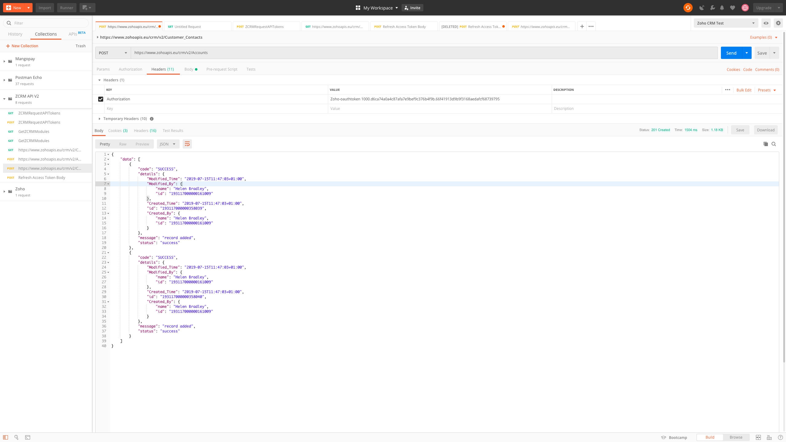
Customers PostMan

Slide 19
Customers Response
{
"data": [
{
"code": "SUCCESS",
"details": {
"Modified_Time": "2019-07-15T11:47:03+01:00",
"Modified_By": {
"name": "Helen Bradley",
"id": "193117000000161009"
},
"Created_Time": "2019-07-15T11:47:03+01:00",
"id": "193117000000358039",
"Created_By": {
"name": "Helen Bradley",
"id": "193117000000161009"
}
},
"message": "record added",
"status": "success"
}
]
}

Slide 20
Priority: Customer Sites
ZCRM Sites

Slide 21
Customer Sites JSON
{
"data": [
{
"Address_2": "API Test Address 2",
"Address_3": "API Test Address 3",
"Address_4": "API Test City",
"Post_Code": "API Test Post Code",
"Country": "API Test Country",
"Address_5": "API Test County",
"Address_1": "API Test Street",
"Name": "API Test Site Code",
"Site_Email": "site@sites.com",
"Phone": "Site PhoneNo",
"Site_Description": "API test site record",
"In_Use": true,
"Contact": {
"name":"",
"id":"193117000000169136"
},
"Company": {
"name":"",
"id":"193117000000169007"
},
"Owner": {
"name":"",
"id":"193117000000161291"
}
}
],
"trigger":[ "workflow"]
}

Slide 22
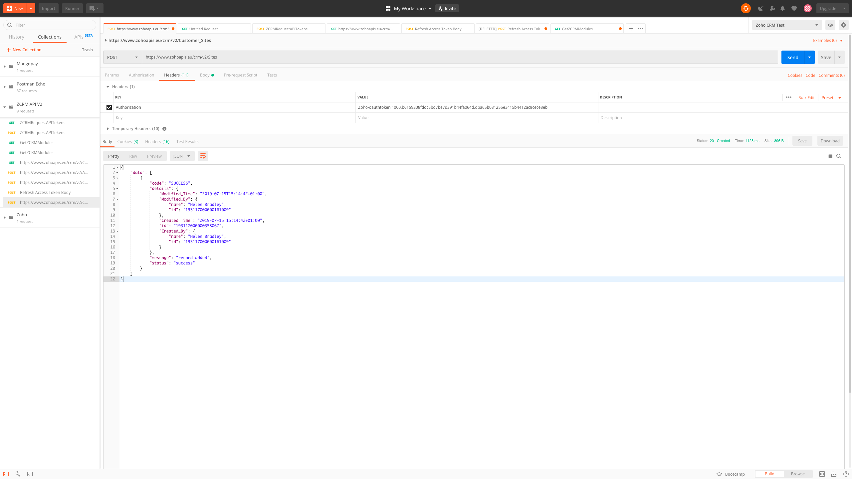
Customer Sites PostMan

Slide 23
Customer Sites Response
{
"data": [
{
"code": "SUCCESS",
"details": {
"Modified_Time": "2019-07-15T15:14:42+01:00",
"Modified_By": {
"name": "Helen Bradley",
"id": "193117000000161009"
},
"Created_Time": "2019-07-15T15:14:42+01:00",
"id": "193117000000358062",
"Created_By": {
"name": "Helen Bradley",
"id": "193117000000161009"
}
},
"message": "record added",
"status": "success"
}
]
}

Slide 24
Priority: Customer Contacts
ZCRM Contacts

Slide 25
Customer Contacts JSON
{
"data": [
{
"Contact_Status1": "API Status",
"Customer_Statement_Contact": true,
"Description": "API Test Description",
"First_Name": "API Test FirstName",
"Invoice_Contact": true,
"Last_Name": "API Test LastName",
"Main_Contact": true,
"Mobile": "API Test Mobile",
"Email": "APITestcontact@apitest.com",
"Phone": "API Test Phone",
"Sales_Order_Contact": true,
"Shipment_Contact": true,
"Title": "Wing Commander",
"Account_Name": {
"name":"",
"id":"193117000000358040"
},
"Owner": {
"name":"",
"id":"193117000000161291"
},
"Site": {
"name":"",
"id":"193117000000356134"
}
}
],
"trigger":[ "workflow"]
}

Slide 26
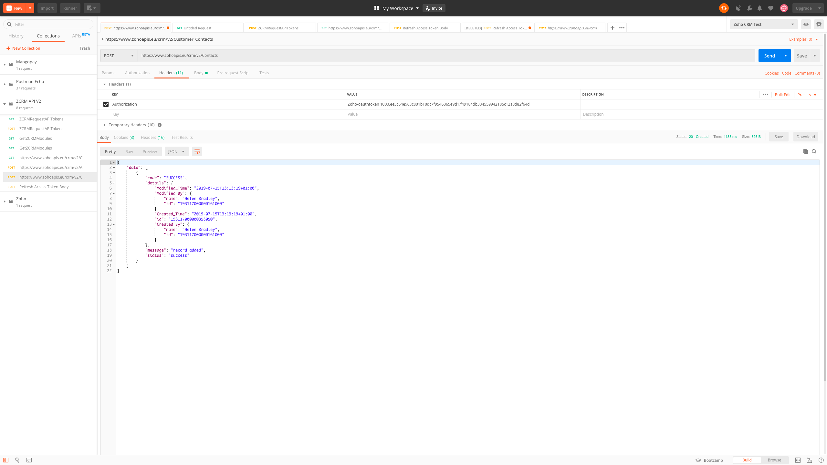
Customer Contacts PostMan

Slide 27
Customer Contacts Response
{
"data": [
{
"code": "SUCCESS",
"details": {
"Modified_Time": "2019-07-15T13:13:19+01:00",
"Modified_By": {
"name": "Helen Bradley",
"id": "193117000000161009"
},
"Created_Time": "2019-07-15T13:13:19+01:00",
"id": "193117000000358050",
"Created_By": {
"name": "Helen Bradley",
"id": "193117000000161009"
}
},
"message": "record added",
"status": "success"
}
]
}

Slide 28
Priority: Customer to Customer Links
ZCRM CustomerLinks

Slide 29
CustomerLinks JSON
{
"data": [
{
"LinkingFrom": {
"name":"",
"id":"193117000000358022"
},
"LinkingTo": {
"name":"",
"id":"193117000000311501"
},
"Default_School":true,
"Generated_by_Priority":true,
"School_Number":"12345",
"School_Customer":"School",
"Owner": {
"name":"",
"id":"193117000000161291"
}
}
],
"trigger":[ "workflow"]
}

Slide 30
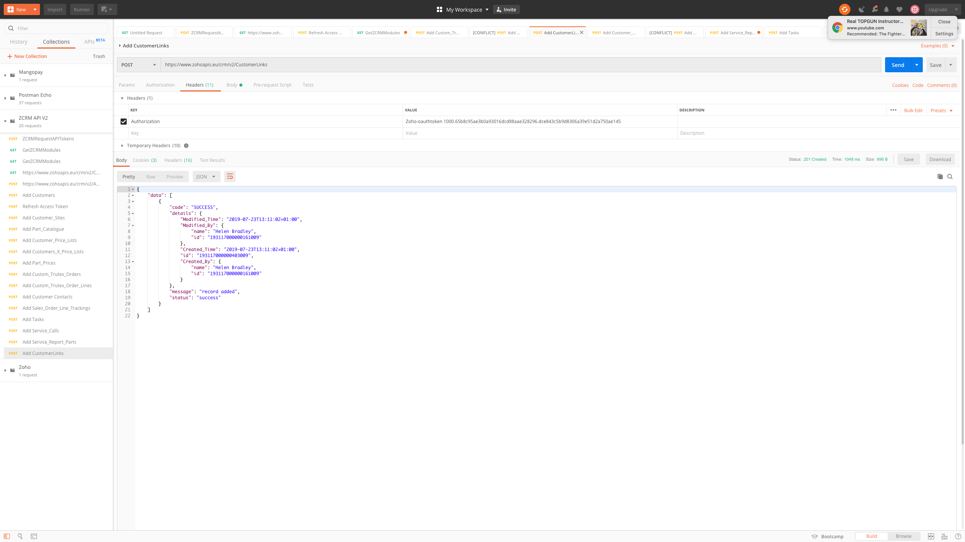
CustomerLinks PostMan

Slide 31
CustomerLinks Response
{
"data": [
{
"code": "SUCCESS",
"details": {
"Modified_Time": "2019-07-23T13:11:02+01:00",
"Modified_By": {
"name": "Helen Bradley",
"id": "193117000000161009"
},
"Created_Time": "2019-07-23T13:11:02+01:00",
"id": "193117000000403009",
"Created_By": {
"name": "Helen Bradley",
"id": "193117000000161009"
}
},
"message": "record added",
"status": "success"
}
]
}

Slide 32
Priority: Parts Catalogue
ZCRM Part_Catalogue

Slide 33
Parts Catalogue JSON
{
"data": [
{
"Name": "API Part Code",
"Part_Description": "API Part Description",
"Bar_Code_Number": "API BarcodeNumber",
"Base_Product_Code": {
"name":"",
"id":"193117000000330197"
},
"Base_Product_Description": "API Test Base Product Description",
"Status_of_Part": "API Test Status",
"Range": "API Test Range",
"VAT_Group_Code": "API Test VAT Code",
"Base_Product": true,
"Is_this_Separate": true,
"Available_for_Sale": "123456",
"Valid_To":"2019-07-31",
"Valid_From":"2019-07-01",
"Standard_Cost":"123.45",
"Cost":"125",
"Currency_Code":"API",
"School_Number": {
"name":"",
"id":"193117000000169007"
},
"Owner": {
"name":"",
"id":"193117000000161291"
}
}
],
"trigger":[ "workflow"]
}

Slide 34
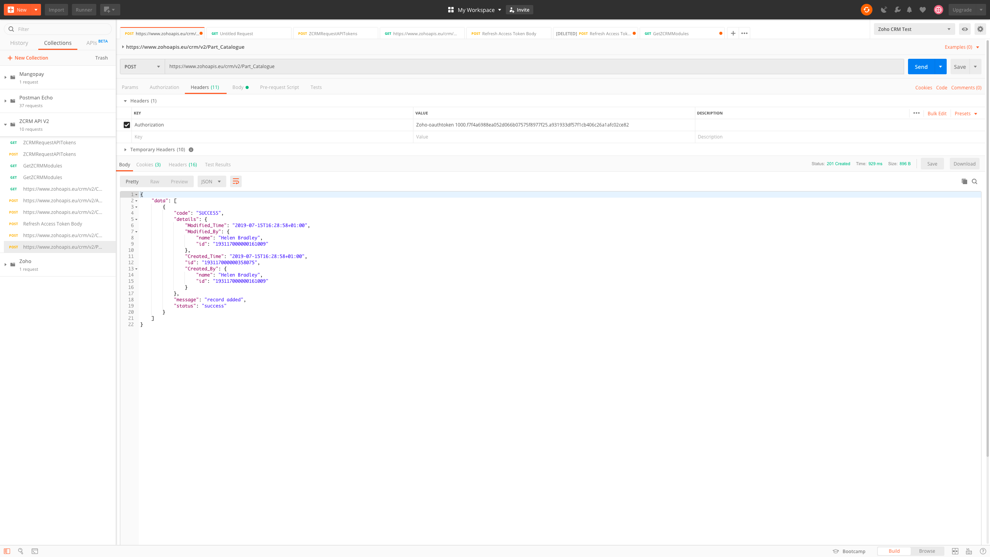
Parts Catalogue PostMan

Slide 35
Parts Catalogue Response
{
"data": [
{
"code": "SUCCESS",
"details": {
"Modified_Time": "2019-07-15T16:28:58+01:00",
"Modified_By": {
"name": "Helen Bradley",
"id": "193117000000161009"
},
"Created_Time": "2019-07-15T16:28:58+01:00",
"id": "193117000000358075",
"Created_By": {
"name": "Helen Bradley",
"id": "193117000000161009"
}
},
"message": "record added",
"status": "success"
}
]
}

Slide 36
Priority: Price Lists
ZCRM Customer_Price_Lists

Slide 37
Price List JSON
{
"data": [
{
"Name": "API PriceList Code",
"List_Description": "API PriceList Description",
"Currency_Code": "API",
"Valid_List_Date": "2019-07-15",
"In_Use": true,
"Owner": {
"name":"",
"id":"193117000000161291"
}
}
],
"trigger":[ "workflow"]
}

Slide 38
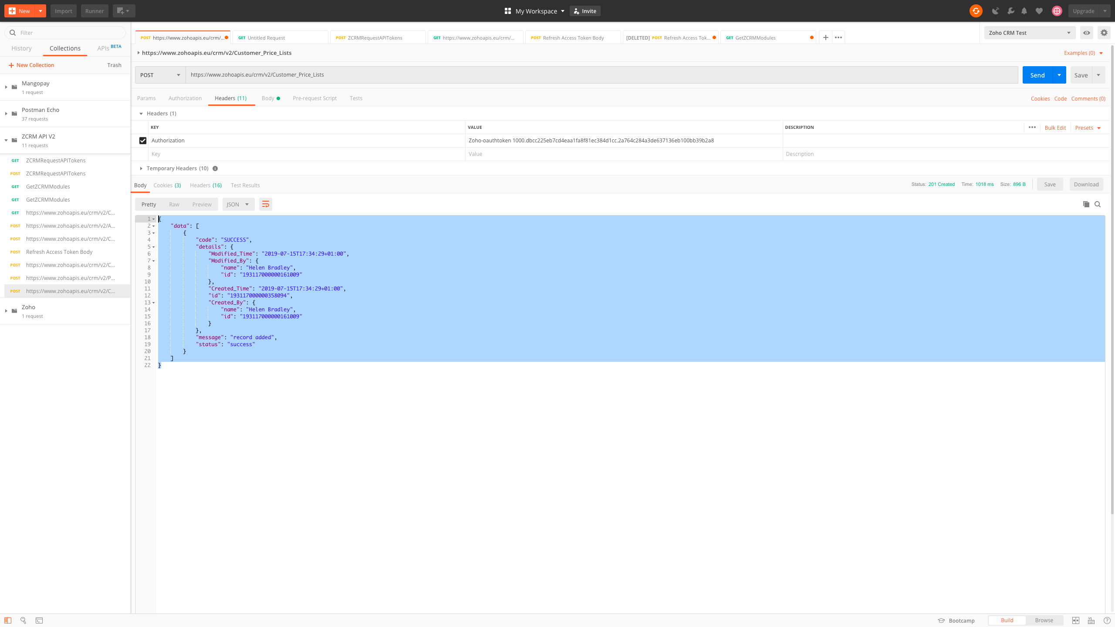
Price List PostMan

Slide 39
Price List Response
{
"data": [
{
"code": "SUCCESS",
"details": {
"Modified_Time": "2019-07-15T17:34:29+01:00",
"Modified_By": {
"name": "Helen Bradley",
"id": "193117000000161009"
},
"Created_Time": "2019-07-15T17:34:29+01:00",
"id": "193117000000358094",
"Created_By": {
"name": "Helen Bradley",
"id": "193117000000161009"
}
},
"message": "record added",
"status": "success"
}
]
}

Slide 40
Priority: Customer Price List Links
ZCRM Customers_X_Price_Lists

Slide 41
Customers_X_Price_Lists JSON
{
"data": [
{
"Customer_Price_Lists": {
"name":"",
"id":"193117000000330158"
},
"Customers": {
"name":"",
"id":"193117000000358040"
},
"Price_List_Priority":"999",
"Owner": {
"name":"",
"id":"193117000000161291"
}
}
],
"trigger":[ "workflow"]
}

Slide 42

Customers_X_Price_Lists PostMan

Slide 43
Customers_X_Price_Lists Response
{
"data": [
{
"code": "SUCCESS",
"details": {
"Modified_Time": "2019-07-15T17:57:11+01:00",
"Modified_By": {
"name": "Helen Bradley",
"id": "193117000000161009"
},
"Created_Time": "2019-07-15T17:57:11+01:00",
"id": "193117000000358101",
"Created_By": {
"name": "Helen Bradley",
"id": "193117000000161009"
}
},
"message": "record added",
"status": "success"
}
]
}

Slide 44
Priority: Part Prices
ZCRM Part_Prices

Slide 45
Part_Prices JSON
{
"data": [
{
""Name":"API Part Price Name",
"Quantity":"1",
"Price":"10.00",
"Price_including_VAT":"12.00",
"Currency_Code1":"API",
"VAT_Group_Code1":"API VAT Code",
"Part_Code": {
"name":"",
"id":"193117000000358088"
},
"Customer_Price_List": {
"name":"",
"id":"193117000000358094"
},
"Owner": {
"name":"",
"id":"193117000000161291"
}
}
],
"trigger":[ "workflow"]
}

Slide 46
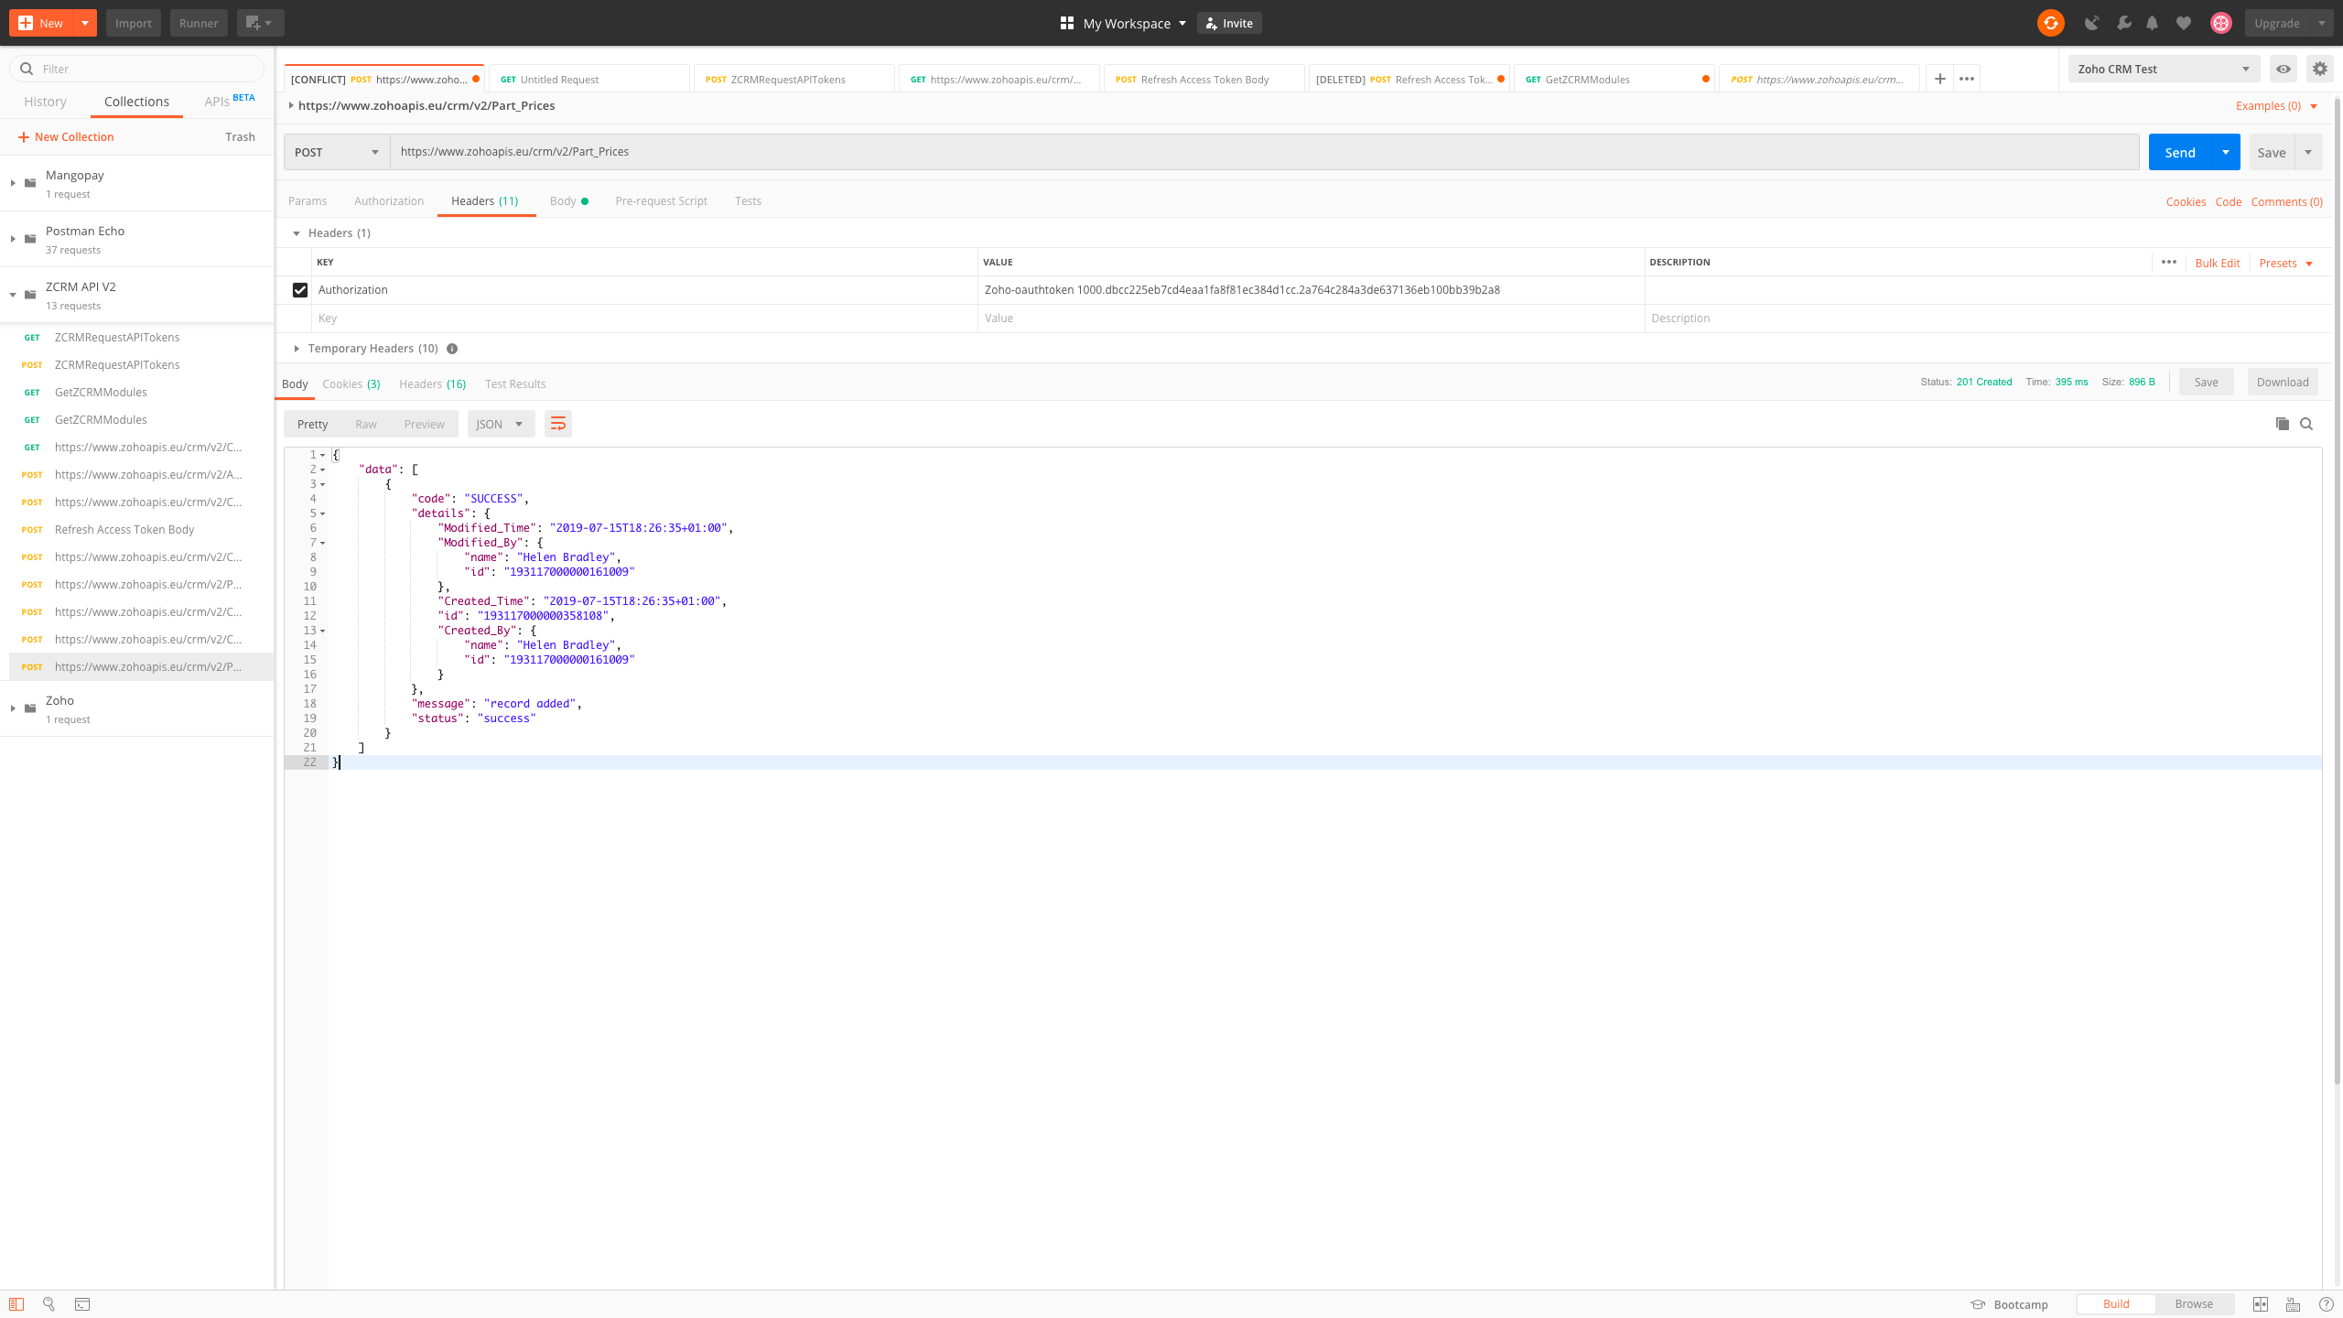
Part_prices PostMan

Slide 47
Part_Prices Response
{
"data": [
{
"code": "SUCCESS",
"details": {
"Modified_Time": "2019-07-15T18:26:35+01:00",
"Modified_By": {
"name": "Helen Bradley",
"id": "193117000000161009"
},
"Created_Time": "2019-07-15T18:26:35+01:00",
"id": "193117000000358108",
"Created_By": {
"name": "Helen Bradley",
"id": "193117000000161009"
}
},
"message": "record added",
"status": "success"
}
]
}

Slide 48
Priority: Sales Orders
ZCRM Custom_Trutex_Orders

Slide 49
Custom_Trutex_Orders JSON
{
"data": [
{
"Customer_Number":"APICustomerNo",
"Customer": {
"name":"",
"id":"193117000000358040"
},
"Priority_Date_of_Sales_Order":"2019-07-16",
"Name":"APISalesOrderNumber",
"Status":"API Status",
"Type_of_Sale_Description":"API Sale Type Description",
"Type_of_Sale_Code":"APITC",
"To_Consignment_Warehouse_Name":"API Warehouse Name",
"To_Consignment_Warehouse_Code":"API",
"Price_Quote_Number":"API Price Quote Number",
"Customer_PO":"API Customer PO",
"Customer_PO_Details":"API Customer PO Details",
"Price_List":"API Price List Name",
"Price_List_Looked_Up": {
"name":"",
"id":"193117000000358094"
},
"Price_after_Discount1":"20.00",
"VAT1":"4.00",
"Final_Price1":"24.00",
"Currency_Code":"API",
"Payment_Terms_Description":"API Payment Terms Description",
"Payment_Terms_Code":"API",
"Order_Received_Date":"2019-07-10",
"Site_Code": {
"name":"",
"id":"193117000000358062"
},
"Site_Contact":"API Contact Name",
"Site_Phone_Number":"01133123456",
"Street_Address":"API Street Address",
"Address_2":"API Address 2",
"Address_3":"API Address 3",
"City":"API City",
"County":"API County",
"Post_Code":"API PostCode",
"Country":"API Country",
"Details":"API Sales Order Details",
"Owner": {
"name":"",
"id":"193117000000161291"
}
}
],
"trigger":[ "workflow"]
}

Slide 50
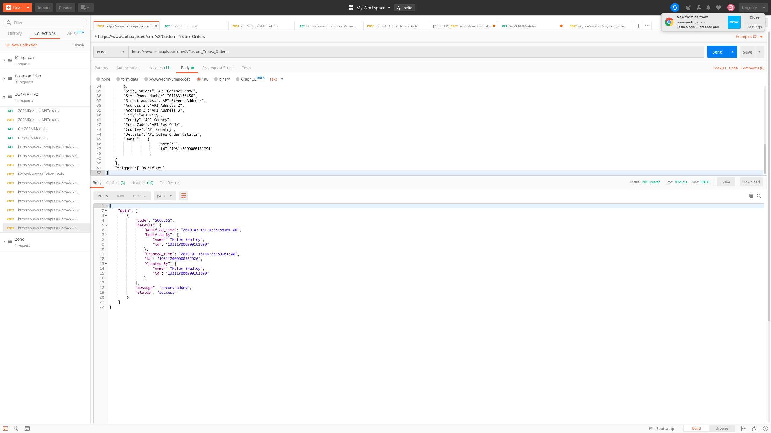
Custom_Trutex_Orders PostMan

Slide 51
Custom_Trutex_Orders Response
{
"data": [
{
"code": "SUCCESS",
"details": {
"Modified_Time": "2019-07-16T14:25:59+01:00",
"Modified_By": {
"name": "Helen Bradley",
"id": "193117000000161009"
},
"Created_Time": "2019-07-16T14:25:59+01:00",
"id": "193117000000362026",
"Created_By": {
"name": "Helen Bradley",
"id": "193117000000161009"
}
},
"message": "record added",
"status": "success"
}
]
}

Slide 52
Priority: Order Items
ZCRM Custom_Trutex_Order_Lines

Slide 53
Custom_Trutex_Order_Lines JSON
{
"data": [
{
"Name":"API Part Number #1",
"Part_Code": {
"name":"",
"id":"193117000000362046"
},
"Part_Description":"API Part Description",
"Part_Status":"API Part Status",
"Quantity":"321",
"Reserved_Quantity":"123",
"Price":"20.01",
"Unit_Price_including_VAT":"24.01",
"Price_Source":"API Price Source",
"Customer_Requested_Date":"2019-07-01",
"Ship_Due_Date":"2019-07-23",
"Balance_Quantity_Outstanding":"56",
"Closed":true,
"Extended_Total_Price":"12345.67",
"Line_Type":"Trutex Sales Order",
"Custom_Trutex_Order": {
"name":"",
"id":"193117000000362039"
} ,
"Owner": {
"name":"",
"id":"193117000000161291"
}
}
],
"trigger":[ "workflow"]
}

Slide 54
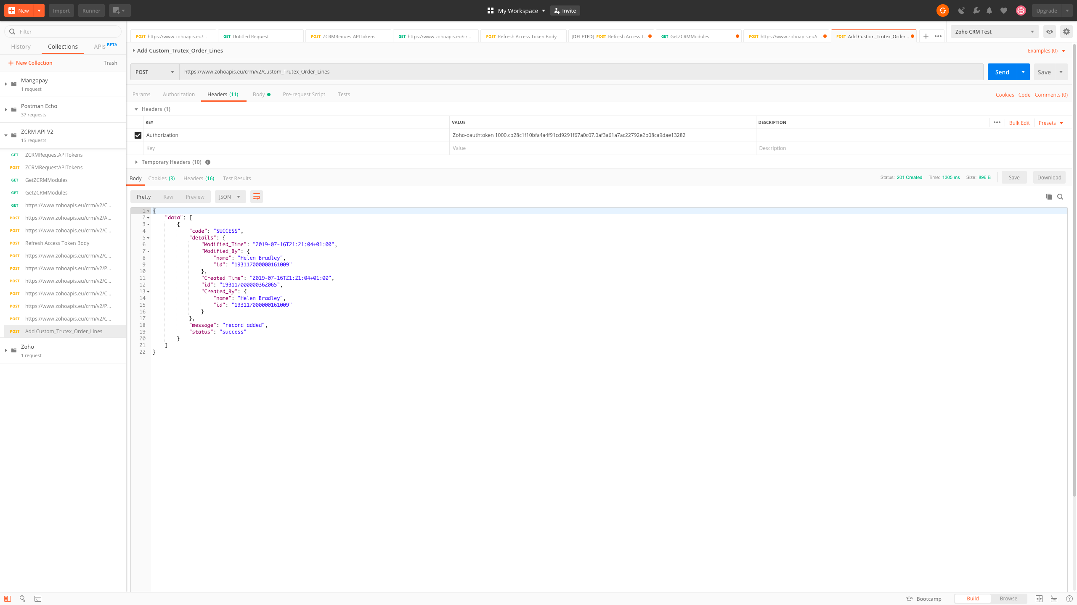
Custom_Trutex_Order_Lines PostMan

Slide 55
Custom_Trutex_Order_Lines Response
{
"data": [
{
"code": "SUCCESS",
"details": {
"Modified_Time": "2019-07-16T21:21:04+01:00",
"Modified_By": {
"name": "Helen Bradley",
"id": "193117000000161009"
},
"Created_Time": "2019-07-16T21:21:04+01:00",
"id": "193117000000362065",
"Created_By": {
"name": "Helen Bradley",
"id": "193117000000161009"
}
},
"message": "record added",
"status": "success"
}
]
}

Slide 56
Priority: Order Tracing
ZCRM Sales_Order_Line_Trackings

Slide 57
Sales_Order_Line_Trackings JSON
{
"data": [
{
"Name": "API Unique Tracking ID",
"Sales_Order_Line": {
"name":"",
"id":"193117000000362065"
},
"Trutex_Sales_Order": {
"name":"",
"id":"193117000000362039"
},
"Date":"2019-07-17",
"Quantity":"20",
"Inventory_Transaction_Type":"APIITType",
"Document_Number":"API Document Number",
"Owner": {
"name":"",
"id":"193117000000161291"
}
}
],
"trigger":[ "workflow"]
}

Slide 58
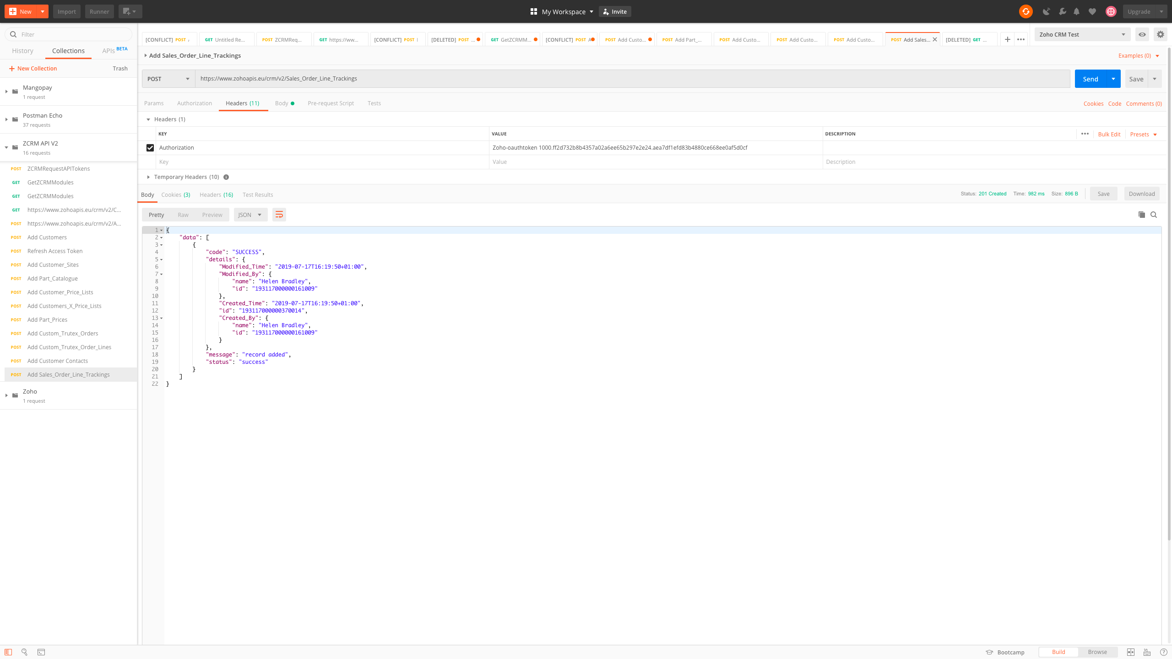
Sales_Order_Line_Trackings PostMan

Slide 59
Sales_Order_Line_Trackings Response
{
"data": [
{
"code": "SUCCESS",
"details": {
"Modified_Time": "2019-07-17T16:19:50+01:00",
"Modified_By": {
"name": "Helen Bradley",
"id": "193117000000161009"
},
"Created_Time": "2019-07-17T16:19:50+01:00",
"id": "193117000000370014",
"Created_By": {
"name": "Helen Bradley",
"id": "193117000000161009"
}
},
"message": "record added",
"status": "success"
}
]
}

Slide 60
Task and Service Call Architecture

Slide 61
Customers
Tasks
Customer
Contacts
Customers
Service
Calls
Line Items
(ZCRM Notes)
Customer
Sites
Service
Report
Parts
Part Catalogue

Slide 62
Priority: Task Logs
ZCRM Tasks

Slide 63
Tasks JSON
{
"data": [
{
"Subject":"API Task Name",
"Owner": {
"name":"",
"id":"193117000000161291"
},
"Who_Id": {
"name":"",
"id":"193117000000362071"
},
"What_Id": {
"name":"",
"id":"193117000000358062"
},
"$se_module":"Sites",
"Generated_by":"Priority",
"Status":"Not Started",
"Due_Date":"2019-07-29",
"Task_Code":"APITaskCode",
"Description":"API Task Description",
"Explanation_of_Task":"API Explanation of task",
"Date_Recorded_with_Timestamp":"2019-07-17T10:00:00+01:00",
"Associated_Document_Number":"APIAssociatedDocumentNumber",
"Associated_Document_Description":"API Associated Document Description",
"Order_Received_Date":"2019-07-17",
"Closed_Time":"2019-07-20T10:00:00+01:00",
"Priority":"Normal"
}
],
"trigger":[ "workflow"]
}

Slide 64
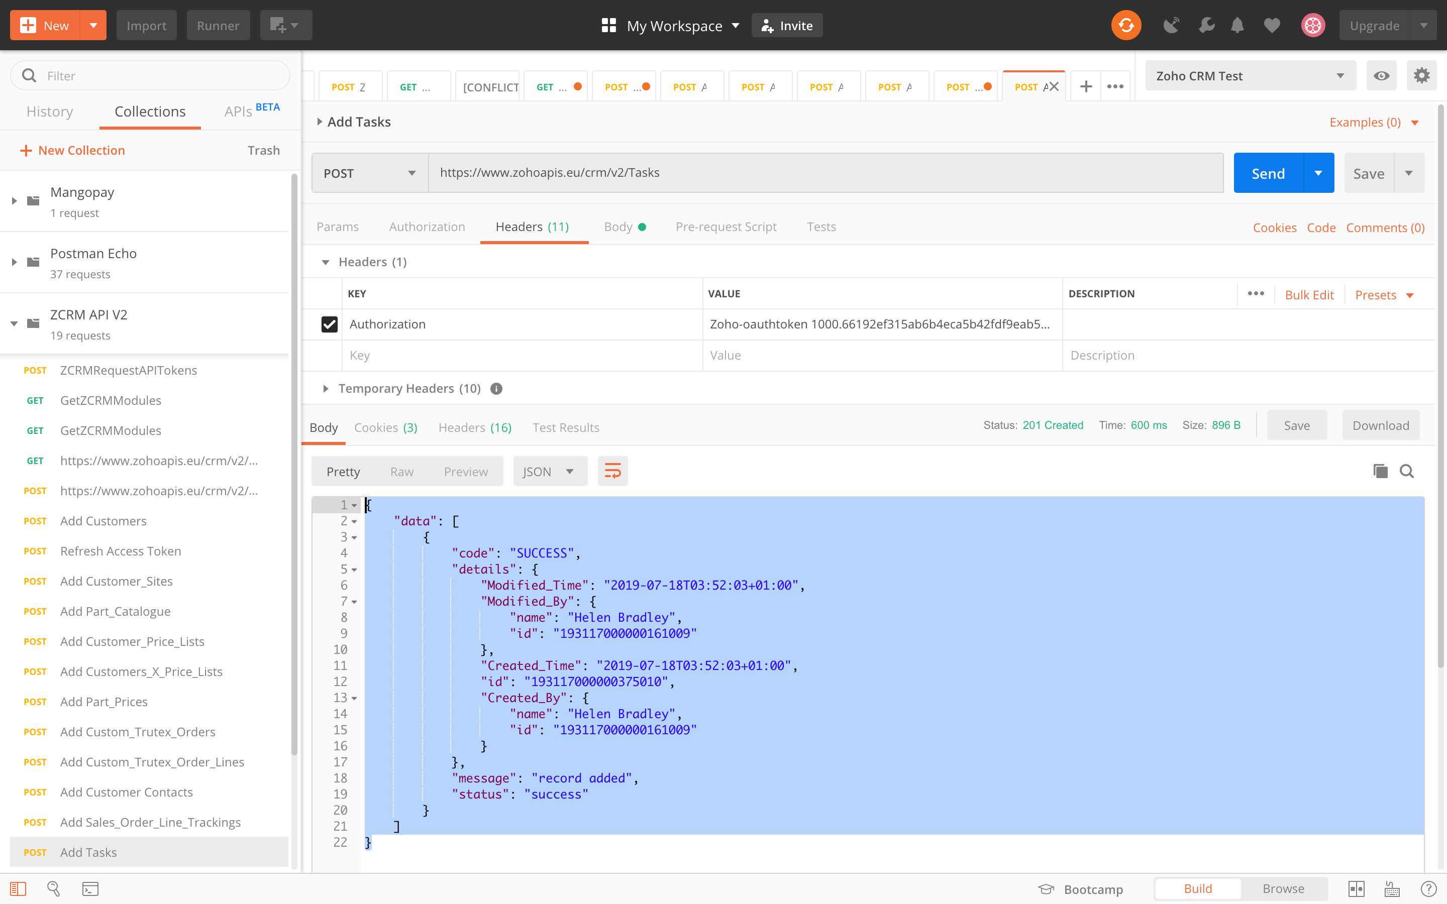
Tasks PostMan

Slide 65
Tasks Response
{
"data": [
{
"code": "SUCCESS",
"details": {
"Modified_Time": "2019-07-18T03:52:03+01:00",
"Modified_By": {
"name": "Helen Bradley",
"id": "193117000000161009"
},
"Created_Time": "2019-07-18T03:52:03+01:00",
"id": "193117000000375010",
"Created_By": {
"name": "Helen Bradley",
"id": "193117000000161009"
}
},
"message": "record added",
"status": "success"
}
]
}

Slide 66
Priority: Service Calls
ZCRM Service_Calls

Slide 67
Service_Calls JSON
{
"data": [
{
"Name":"API Service Call Number",
"Customer_Name": {
"name":"",
"id":"193117000000358040"
},
"Customer_Number":"APICustomerNumber",
"Customer_Site": {
"name":"",
"id":"193117000000358062"
},
"Date_Service_Call_Opened":"2019-07-03",
"RMA_Number":"API RMA Number",
"Status_of_Call":"API Call Status",
"Price_After_Discount":"20.01",
"VAT":"4.01",
"Total_Price":"24.01",
"Currency_Code":"API",
"Owner":{
"name":"",
"id":"193117000000161291"
}
}
],
"trigger":[ "workflow"]
}

Slide 68
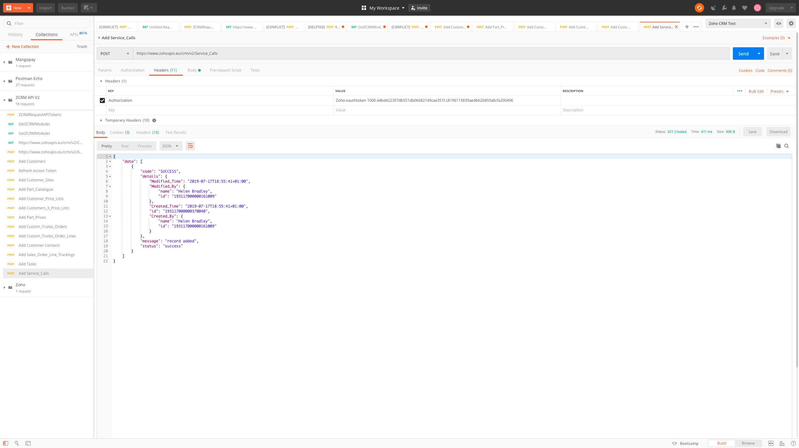
Service_Calls PostMan

Slide 69
Service_Calls Response
{
"data": [
{
"code": "SUCCESS",
"details": {
"Modified_Time": "2019-07-17T18:55:41+01:00",
"Modified_By": {
"name": "Helen Bradley",
"id": "193117000000161009"
},
"Created_Time": "2019-07-17T18:55:41+01:00",
"id": "193117000000370040",
"Created_By": {
"name": "Helen Bradley",
"id": "193117000000161009"
}
},
"message": "record added",
"status": "success"
}
]
}

Slide 70
Priority: Service Report Parts
ZCRM Service_Report_Parts

Slide 71
Service_Report_Parts JSON
{
"data": [
{
"Name":"API Service Report Part Number",
"Part_Number": {
"name":"",
"id":"193117000000362046"
},
"Part_Description":"API Part Description",
"Planned_returned_Quantity":"999",
"Actual_returned_Quantity":"111",
"Planned_Quantity":"222",
"Actual_Quantity":"221",
"Planned_Defect_Description":"API Planned Defect Description",
"Planned_Defect_Code":"PlannedDCode",
"Defect_Code":"DCode",
"Description_of_Defect":"Description of Defect",
"Call_Type":"Call Type",
"Owner": {
"name":"",
"id":"193117000000161291"
},
"Service_Call": {
"name":"",
"id":"193117000000370040"
}
}
],
"trigger":[ "workflow"]
}

Slide 72
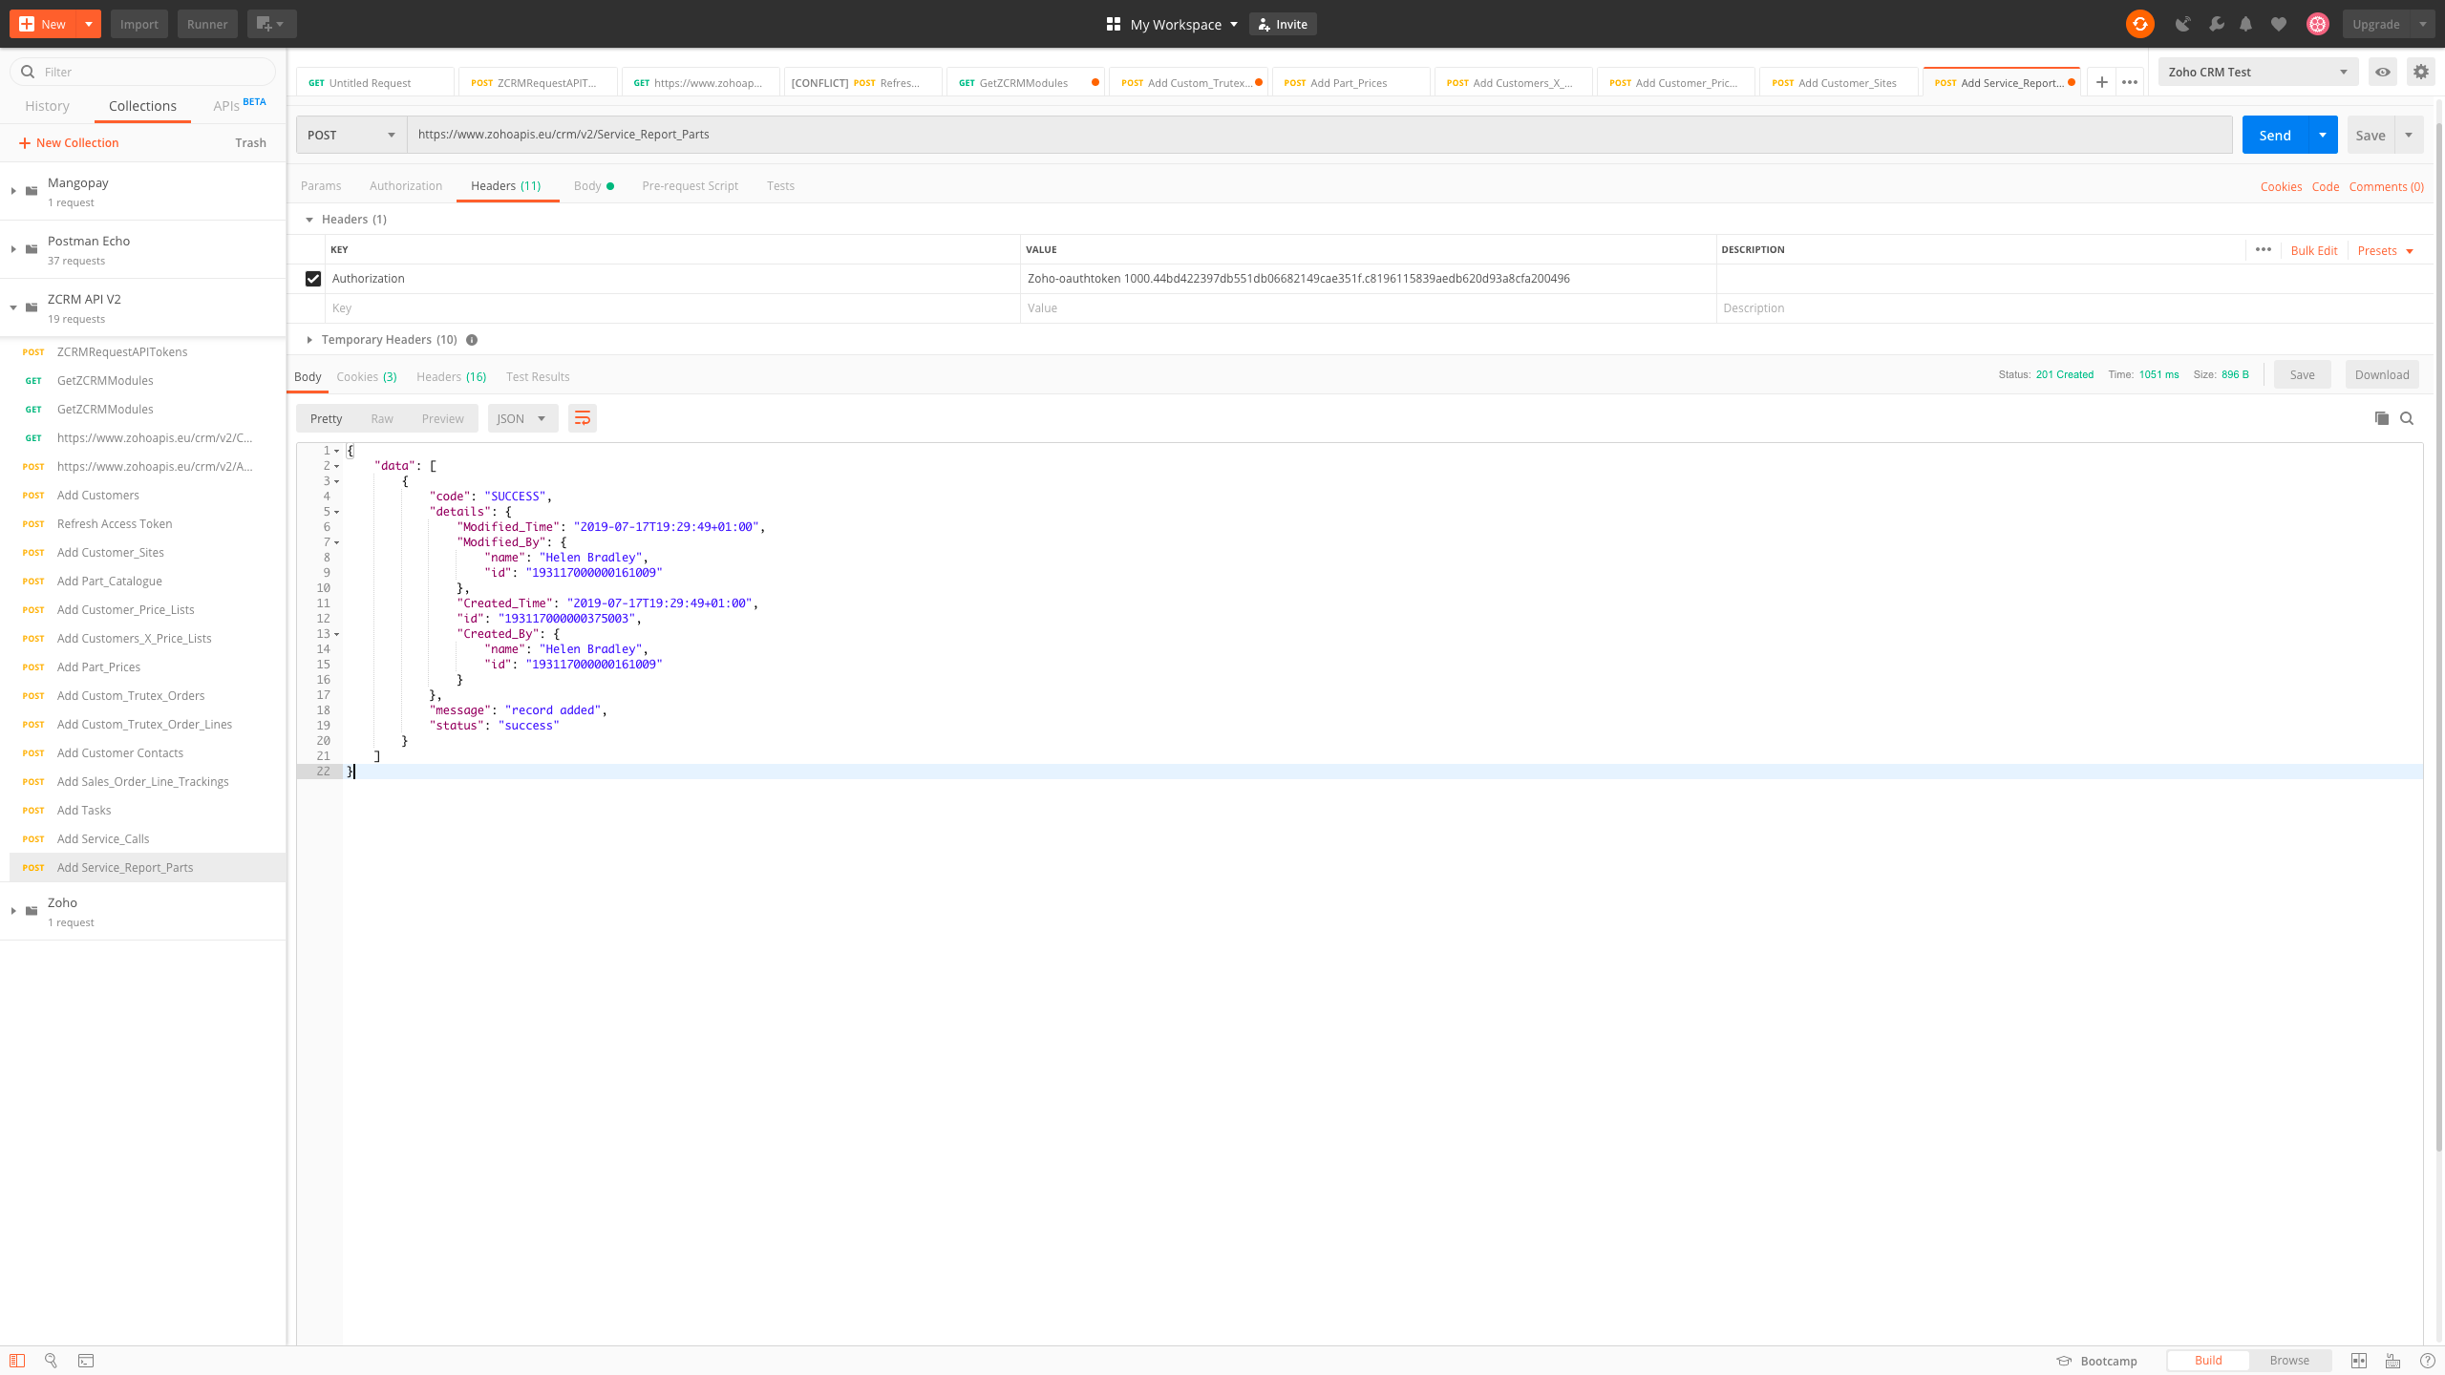
Service_Report_Parts PostMan

Slide 73
Service_Report_Parts Response
{
"data": [
{
"code": "SUCCESS",
"details": {
"Modified_Time": "2019-07-17T19:29:49+01:00",
"Modified_By": {
"name": "Helen Bradley",
"id": "193117000000161009"
},
"Created_Time": "2019-07-17T19:29:49+01:00",
"id": "193117000000375003",
"Created_By": {
"name": "Helen Bradley",
"id": "193117000000161009"
}
},
"message": "record added",
"status": "success"
}
]
}

